Slide 1
ISOLATION
Friendships are suffering during the pandemic

Slide 2
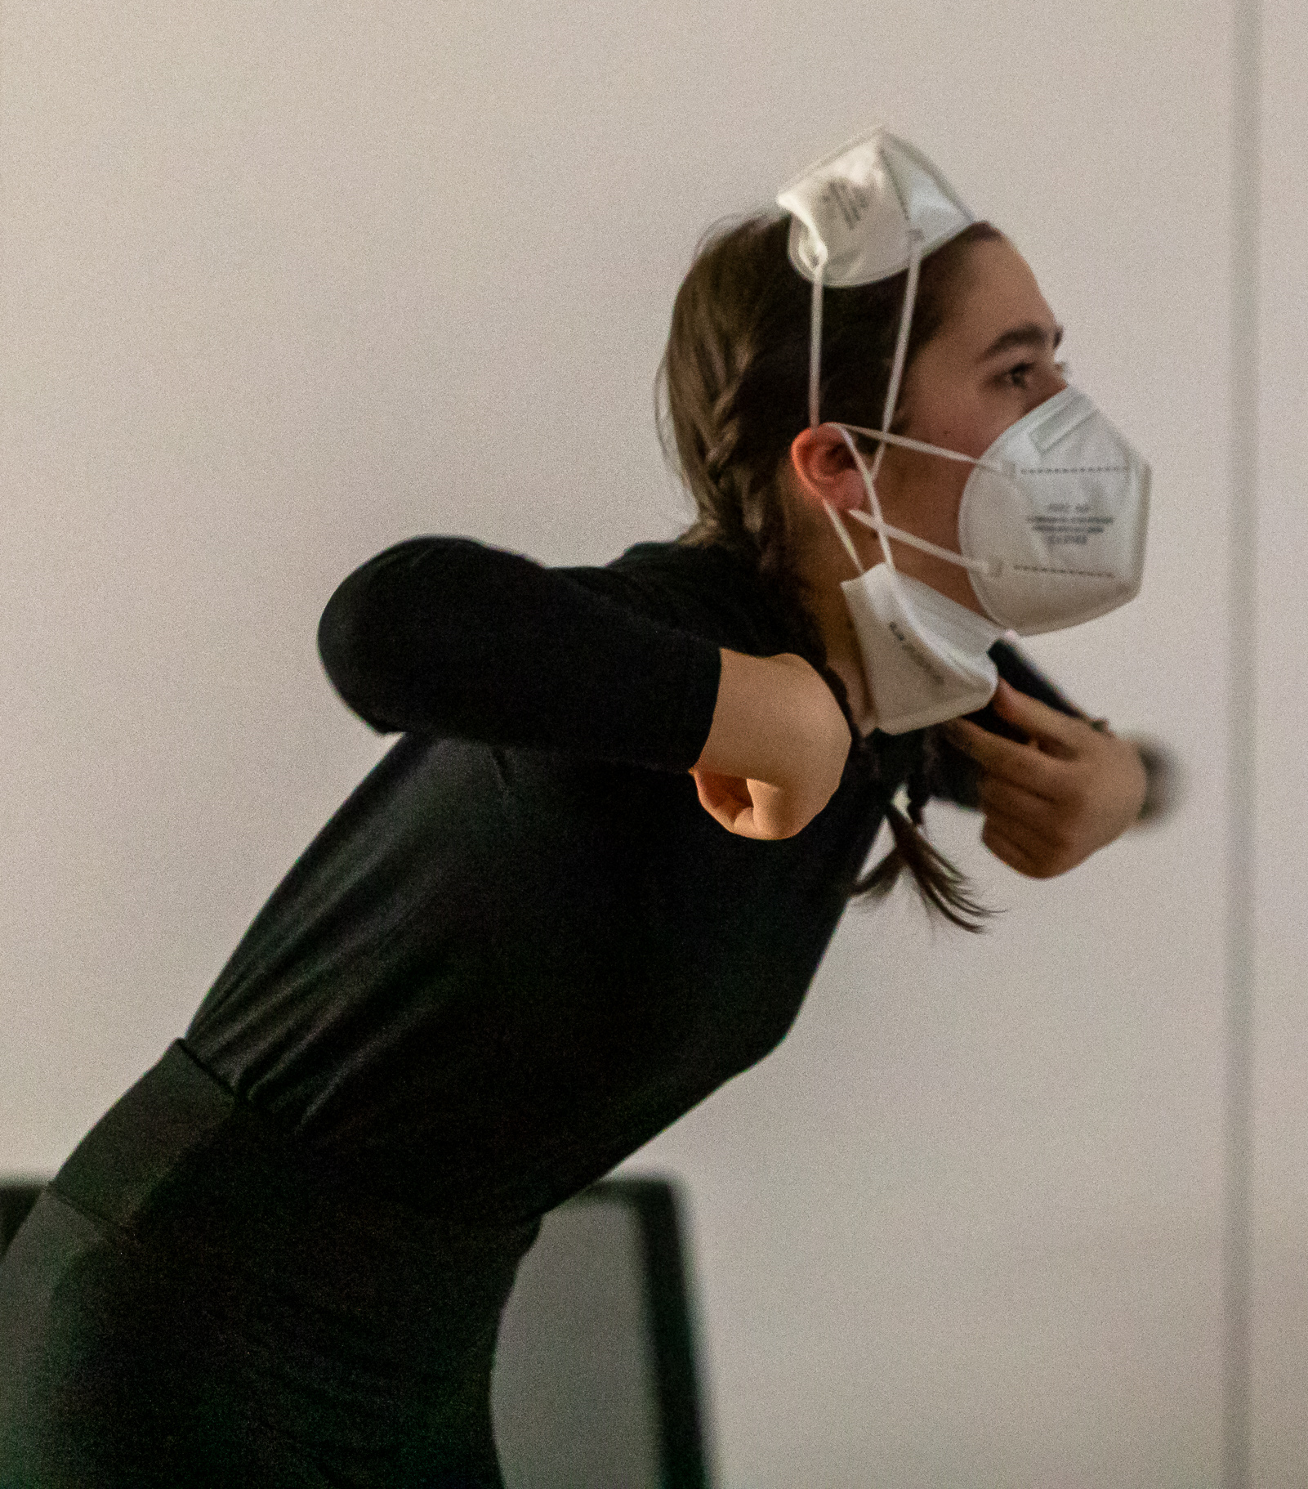
One mask,
two masks?
Where am I staying? Your girlfriend???
A protective
suit too???
During the pandemic, encounters between friends were put to great tests.
It was about questions like:
Have you been vaccinated?
Are you wearing a face mask?
Do you have sanitiser with you?
Are you keeping a distance of 2 metres?

Slide 3
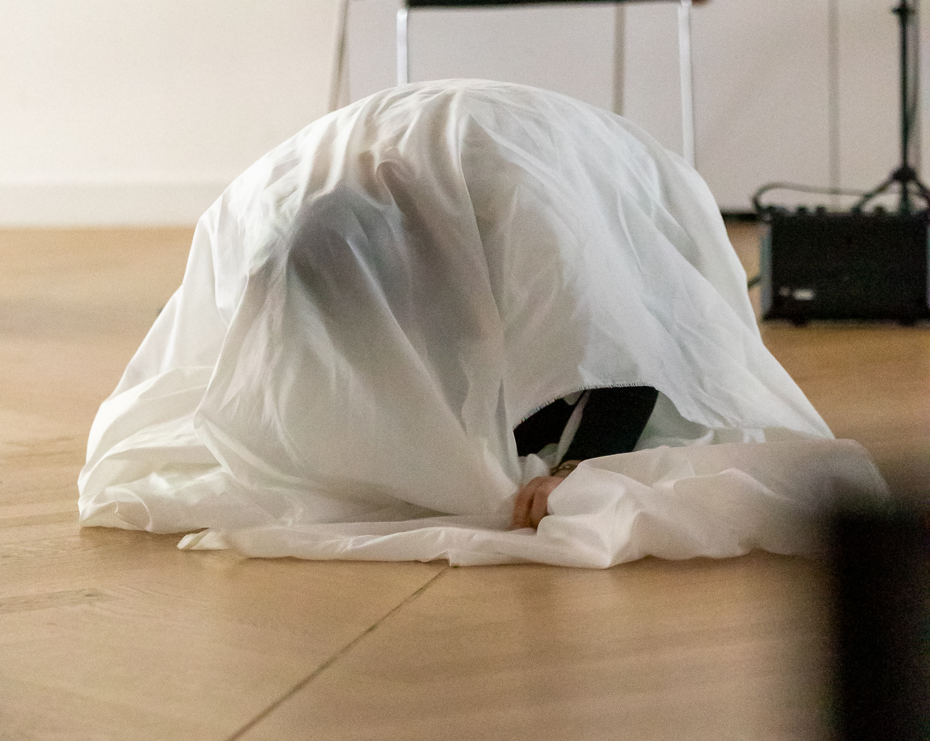
NO! That's enough!
Wrapped up - like in a cocoon!
The pupils present in an excellent way how distance, isolation distance, isolation, defence and loneliness creep in.Until you finally despair all alone and without contact!

Slide 4
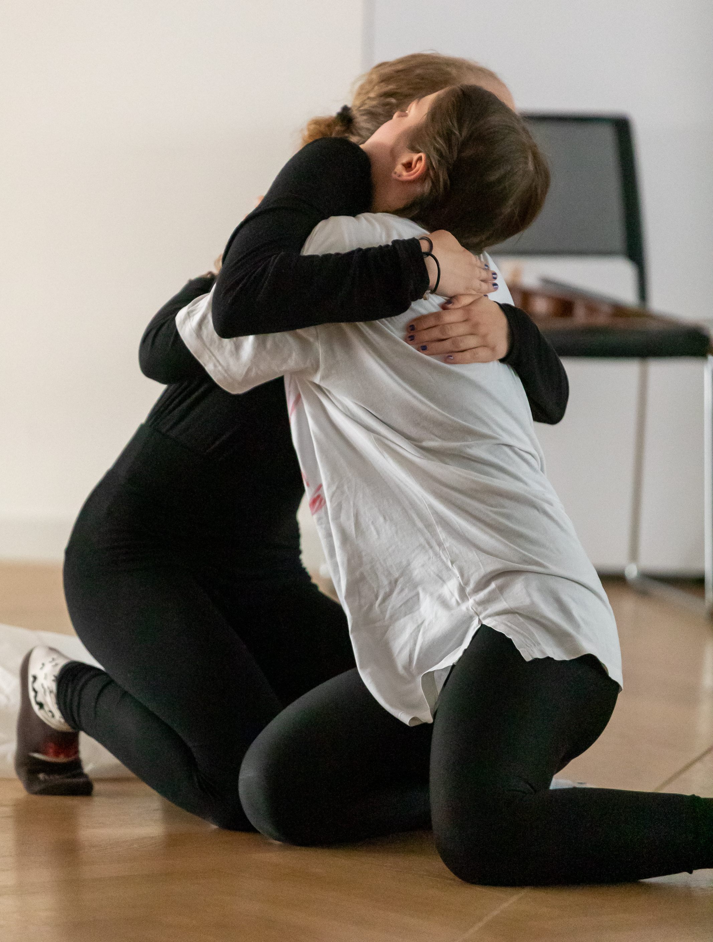
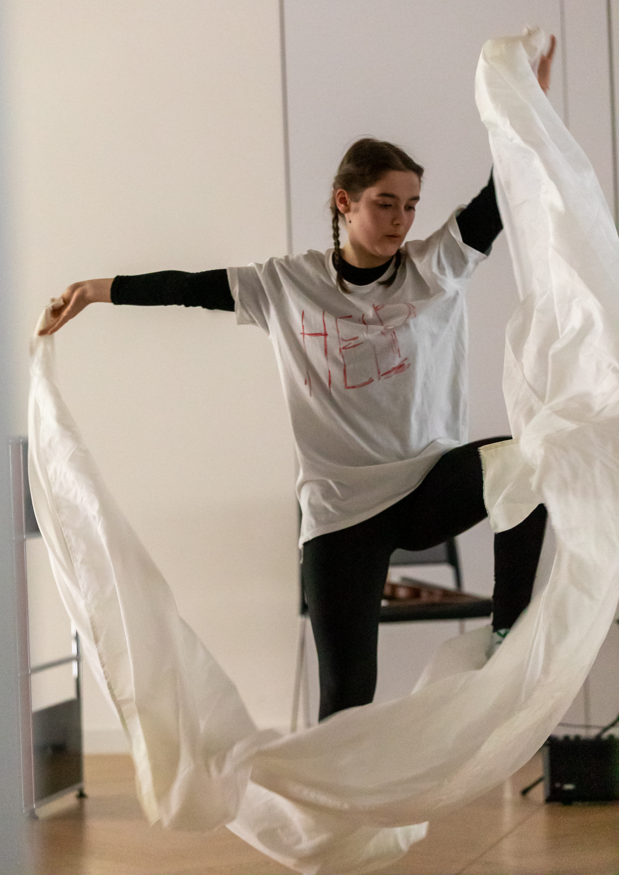
But friendship
is stronger and loneliness is broken up!
Distance and isolation can make people sad, depressed and ill. We need YOU to feel accepted!

Slide 5
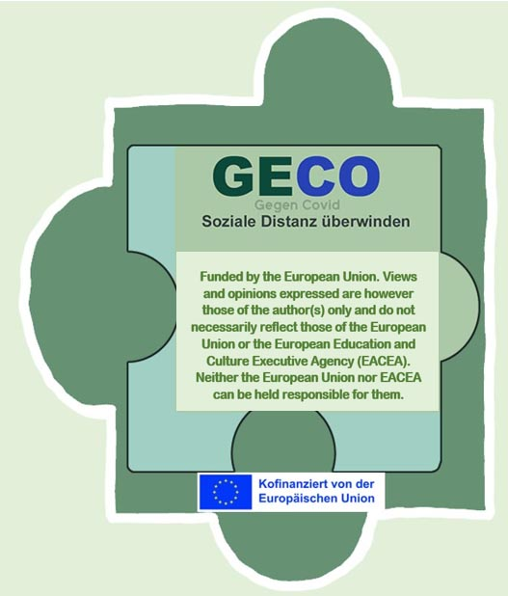
In Europe Week 2023, Ema Mihálikov and Tereza Siroká from Bratislava, SK, depict the turmoil that many people have experienced during the coronavirus pandemic in impressive scenes.
Especially for young people, for whom contact with friends means a lot, it was a paralysing and sad situation not to be able to maintain friendly contact as usual.
The two schoolgirls used simple images to skilfully depict this dilemma and the strain that friendships had to endure.

