Slide 1
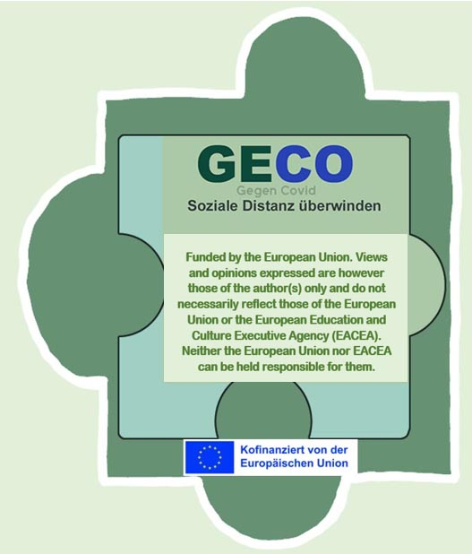
Architecture / Urbanism
How new concepts can help people make friends

Slide 2
Excursion to Bratislava
At a project meeting we had the opportunity to visit
the places mentioned in the essay on architecture.

Slide 3
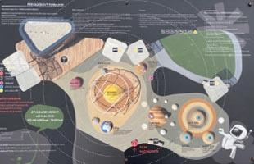
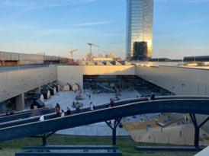
We visited the Green Roof

Slide 4
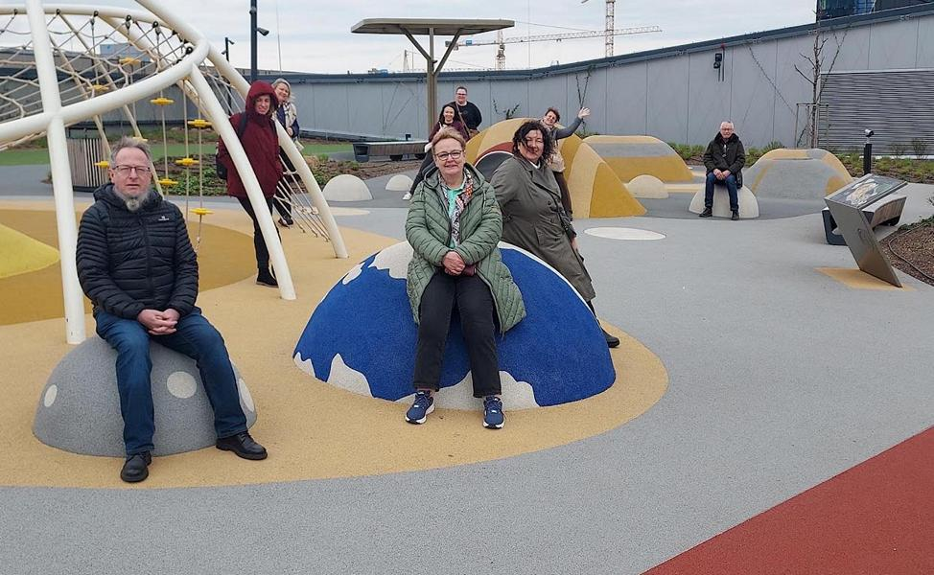
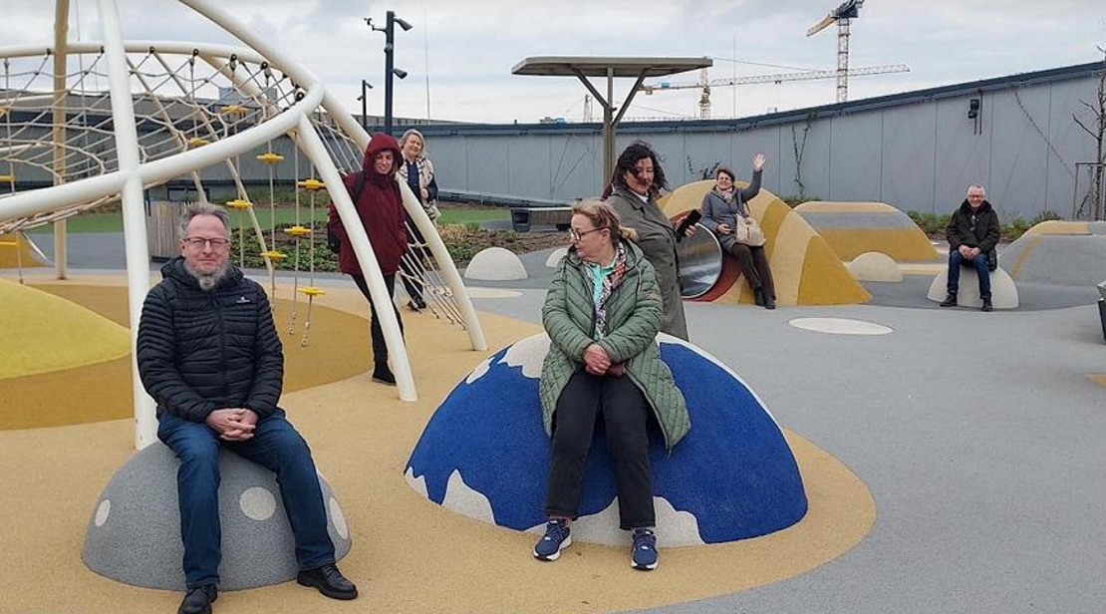
We have seen the ‘star playground’

Slide 5
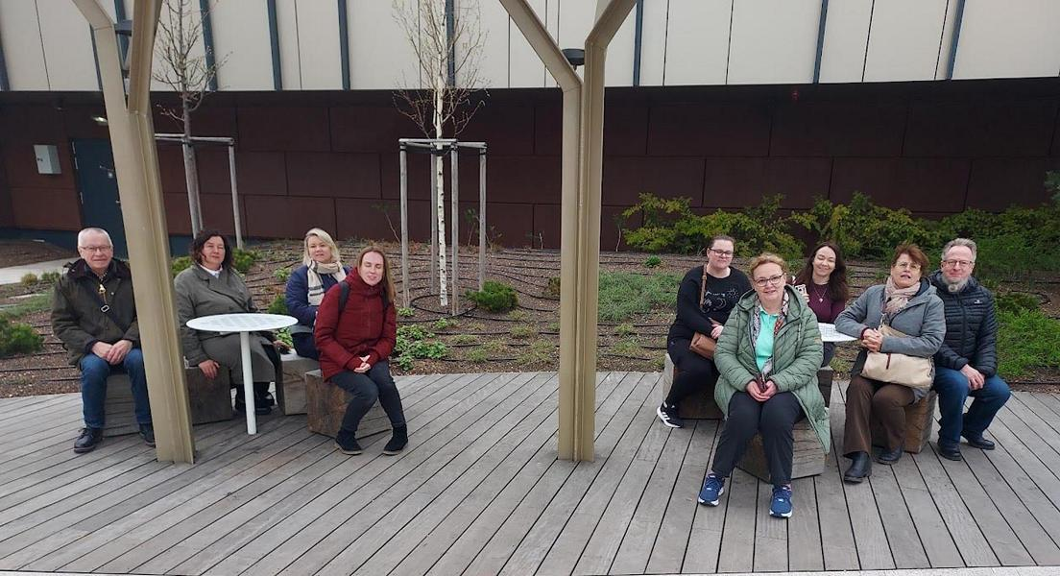
We tried out the seating, relaxation and communication stations

Slide 6
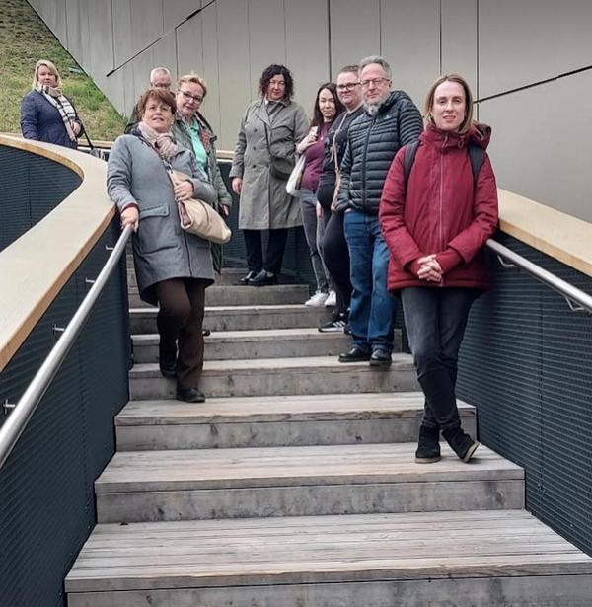
We walked around the various roof floors

Slide 7
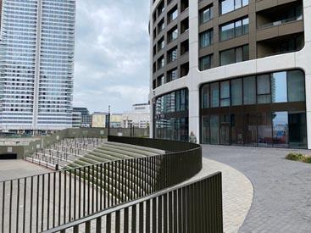
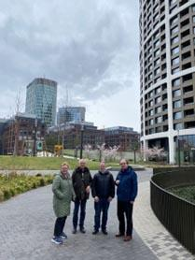
And we studied the concept in the new SKY PARK residential area

Slide 8
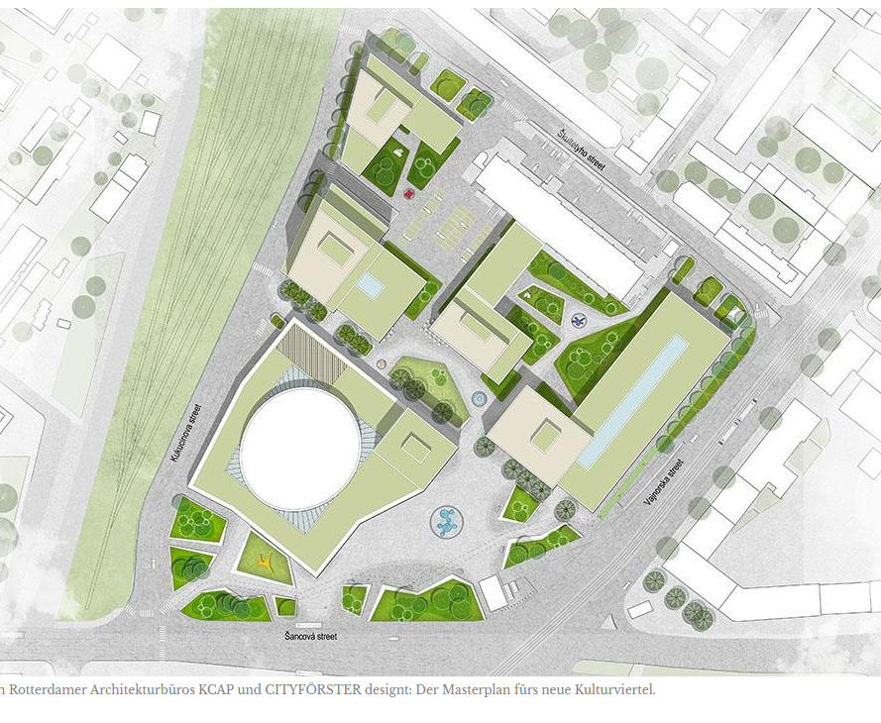
Conclusion
The city of Bratislava is creating an innovative, car-free mixed-use neighbourhood.
The big goal: to create an ‘urban living room’ in which art, culture and creativity are an integral part of everyday life and distance and isolation are overcome.
During the excursion, we were able to see that much of the ‘urban living room’ has already been realised.
The ambitious goal of combining work, recreation, communication and private space and thus creating new meeting places is being pursued intensively and realised in an impressive manner.
Quelle:https://www.ubm-development.com/magazin/bratislava-baut-auf-kultur/

