Slide 1
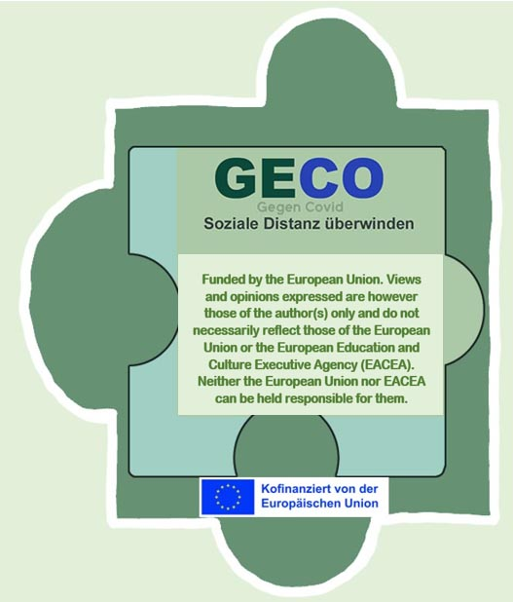
Social Distancing Questionaire Status quo of the partners at the start of the project

Slide 2
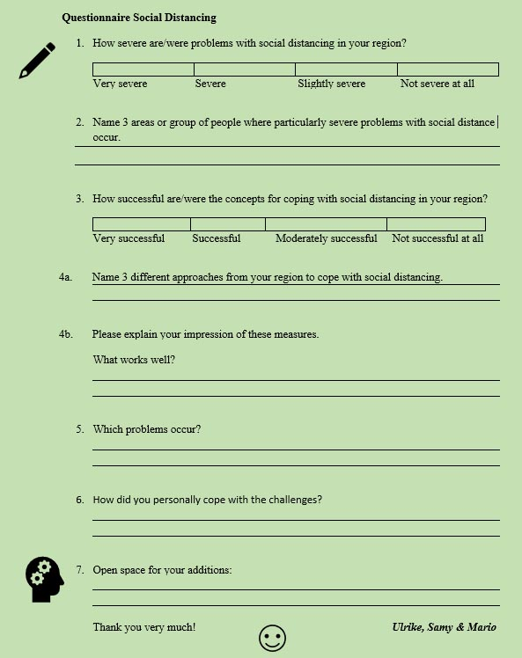
At the beginning of the project, all partners received a questionnaire to record how the partners in the various countries perceive the situation. Some important results are briefly presented on the following pages:

Slide 3
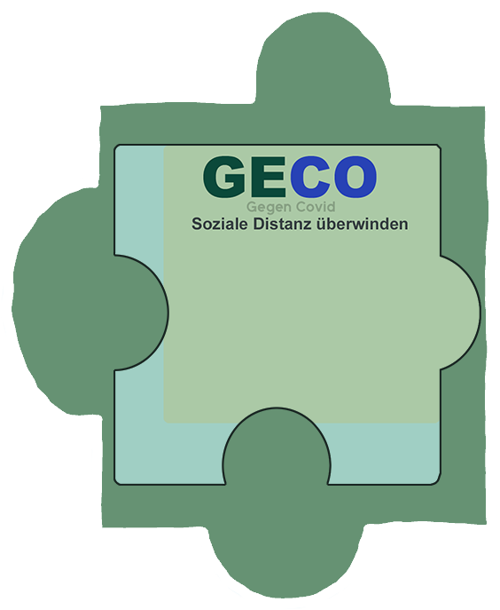
Particularly affected areas and people
Addicted persons
Ethnic groups
People with diverse sexuality
Elderly
The sick and ill
Teachers
Elderly
Schools
Students (9 to 19)
Relationships
Shops
The socially disadvantaged
People living alone
Friendships
Shops
Small work spaces
Pupils
Children
Nursing homes
Students
Cafés

Slide 4
Particularly affected
Areas and People
Age Groups:
Pupils & Students
Elderly
Areas:
Nursing Homes
Schools
People affected by risk factors
(bad health conditions and/or living alone)
Minorities
Ethnic Groups
People with a diverse sexual orientation

Slide 5
Coping Approaches
Raising awareness (ethnic groups)
Home Delivery
Nursing Home Concepts
Homeschooling
Online theatre
Online communication
Supermarket Home Delivery
Homeschooling
Keeping routine
Home Delivery
Homeschooling
Private Parties
Online Seminars
Staying connected
Taking time out
Takeaway Gastronomy

Slide 6
Coping Approaches
Remote Infrastructure:
Home Delivery Services
Homeschooling
Video Calls
Social Media
Individual Coping:
Private Parties
New Routines
Private Projects
Time-Outs

Slide 7
Positive and Negative
War
Problematic communication (ethnic groups)
Quick adapting
Technical equipment
Lack of experience (Homeschooling)
Quick adapting
Bigger workload and responsibility
Low Accessibility
Demotivation
Lack of physical contact
Establishing permanent services
Technical infrastructure
New ways of learning
Social bubbles
Extremism
Isolation
Technical difficulties
Staff shortage
Internet issuees
Anxiety
Customer gain

Slide 8
Positive and Negative
Positives:
Quick adapting
Permanent Services
New ways of Learning
Customer Gain
Negatives:
Technical Infrastructure is lacking
Low Accessibility
Staff Shortage
No Physical Contact
Bigger workloads
War
Problematic Communication
Isolation & Demotivation
Social Bubbles
Extremism
Anxiety

