Slide 1
Evaluation after two Years

Slide 2
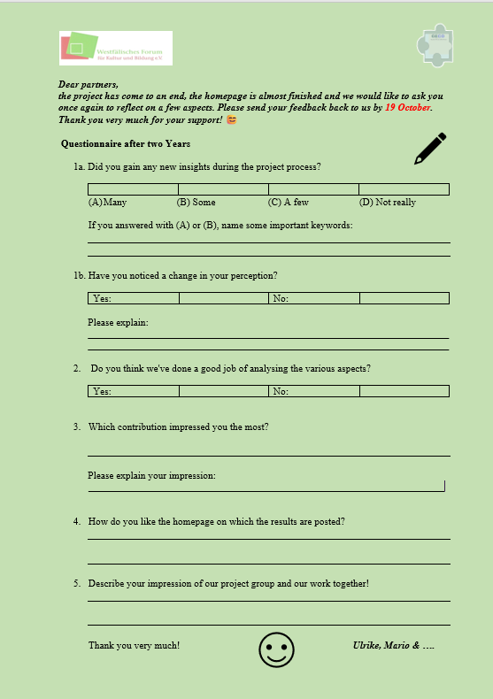
At the end of the project, the coordinators were asked how
they rated the work, the results and the presentation on the homepage.
The coordinators from all seven organisations gave their feedback. Accordingly, a total of seven responses were received.

Slide 3
1a. Did you gain any new insights during the project process?

Slide 4
1a. Additional keywords
The following aspects were mentioned in explanation:
wide variety of examples
very different groups
new insights
improved management skills
the pressure of suffering on young people
fatal consequences for the elderly
rapid technical reactions
cultural differences in solution strategies
innovative ideas
self-perception
reflection
social distancing not only during the pandemic
Loneliness is not age-dependent
need for help

Slide 5
1b. Have you noticed a change
in your perception?
Everybody answered with „YES“, N = 7

Slide 6
1b. Additional keywords
The following aspects were mentioned in explanation:
broadening horizons
similar problems => different solutions
new perspectives (3x)
new information (4x)
better attention needed for children and disabled people
need for support for young people
prevent loneliness
N = 7
Quote: ‘Finding the truth can be very difficult!’

Slide 7
2. Do you think we've done a good job of analysing the various aspects?
Everybody answered with „YES“

Slide 8
3. Which contribution impressed you the most?
Summary of the answers: a wide range is covered here, but there are also an astonishing number of similarities!
the diary entries are touching
very personal and private impressions have been captured (3x)
it has been possible to portray personal feelings and solutions
the material can be used well for further learning processes
the Slovakian scenes are impressive (5x)
the Finnish scenes are impressive (3x)
the statements are credible
an unhealthy acute environment becomes clear
many people live in toxic relationships

Slide 9
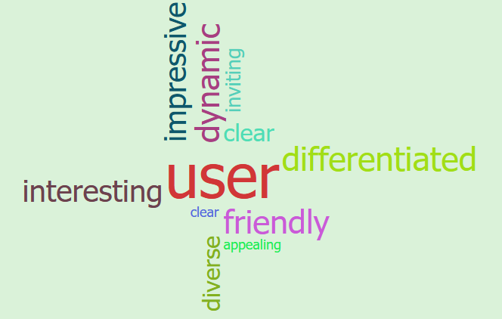
4. How do you like the homepage on
which the results are posted?
This question was also answered in a differentiated manner:

Slide 10
Additional Remarks
In addition to the judgemental adjectives, there were also comments on the possible use of the site:
The material can be used well for learning processes
The examples can be used in a variety of ways
The project results can be used not only in the school/university context, but also as an information tool for public relations work

Slide 11
5. Describe your impression of our project group and our work together!
These answers have made it clear why it was possible to show differentiated results and well-done video examples on the homepage: the project group worked well!
The atmosphere was good and very pleasant.
I feel it was a great success.
We were a good team (4x).
Different backgrounds were brought in (3x).
Some of the results were eye-opening,
The work was well organised (3x),
The work plan was clearly structured and was well adhered to (3x).
The discussions at the meetings were very intensive.
The co-operation was good and conflict-free.
The structure was constructive and goal-orientated.
Mutual support was a matter of course.

Slide 12
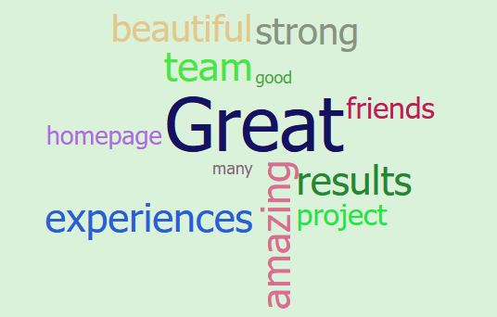
Conclusion :

